Slide 1
Azure Solution Alignment Workshop
Module 5b – Compute PaaS

Slide 2
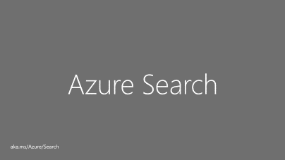
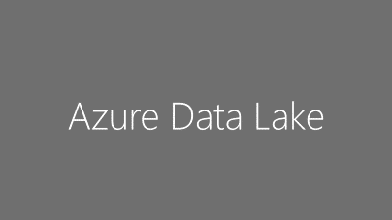
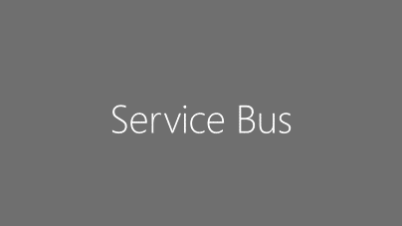

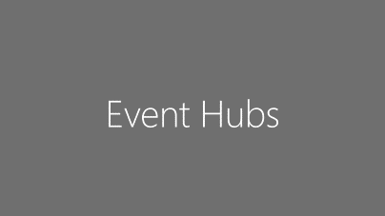
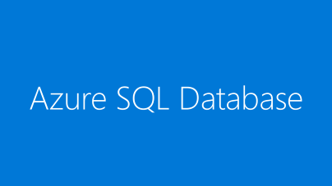
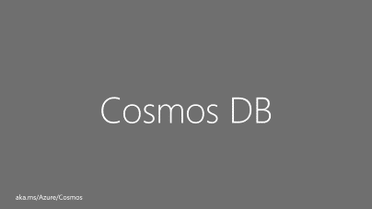
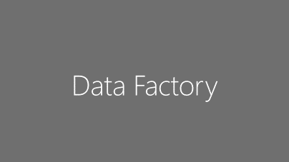
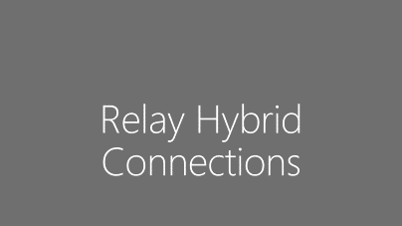
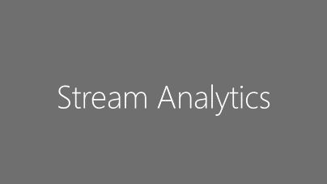
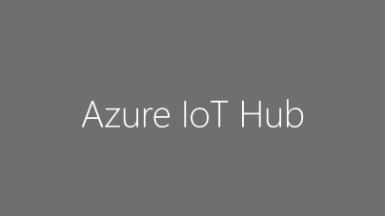
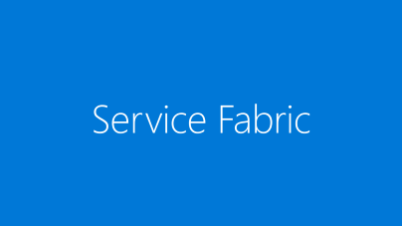
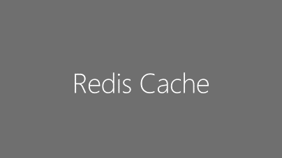
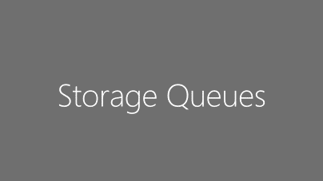
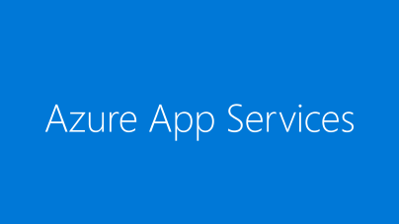
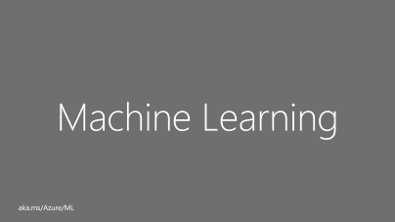
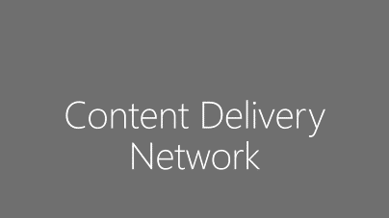

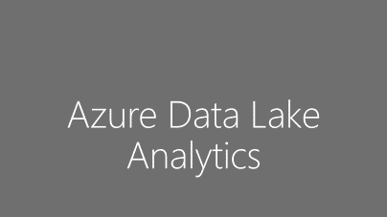
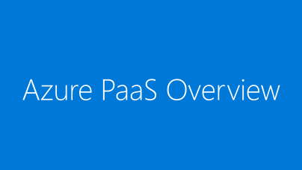

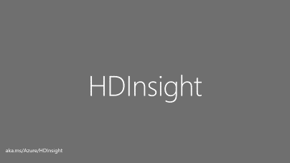
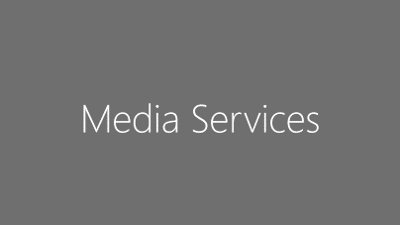
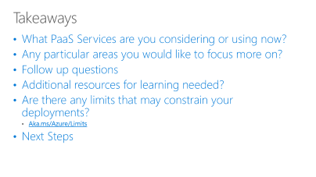
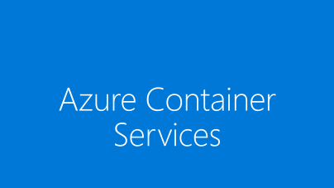
PaaS Menu Blue Core, Grey optional
Notes:
NOTE: The focus should be on delivering the Blue Boxes. Those are the core PaaS pieces that most organizations are interested in. The grey boxes are informational if they are interested. In many cases, you may not be an expert nor even at 200 level for most of those services. If the customer is really interested in any of the grey boxes, and you do not have the time to ramp up heavily, it would be worth bringing a SME into a call for that topic. Always keep in mind though to stick to SOW. These slides are just overviews. Unless a particular grey box topic is called out in the SOW, there is no need to dive much deeper without a change request to the project or incurring project scope creep.

Slide 3
Azure PaaS Overview

Slide 4



Let’s say your app is a car…
IaaS
PaaS
SaaS
…you can own and operate your own car
…you can rent a car
…you can take a taxi
Cut to the code - create innovative apps using an application platform
Notes:
[Speaker Guidance: Most of your audience will own a car, and likely be happy with that ownership. This is an analogy to help understand the differences, but don’t try to push the analogy too far. ]
Objective:
Illustrate the differences between IaaS, PaaS and Saas in a simplistic, easy to understand way.
Key talking points:
So what differentiates a developer platform from an infrastructure platform?
It’s pretty simple, there are tiers of responsibility with benefits and tradeoffs between them. For example, to use a car analogy, if you own a car you have to go through the purchase process, buy insurance, maintain and service it over a long period of time, provide parking or garaging (you get the idea).
If you’re renting a car, you get the benefit of a car at your disposal for a fixed time period without any of the overhead of ownership – like maintenance and insurance.
An Uber or a taxi is likely to be the most affordable option, but can have limits on flexibility—you might have to wait five minutes, or maybe stand out in the rain waiting for a ride.
Likewise, building apps on IaaS is a perfectly valid approach. It gives you maximum control and flexibility to run whatever you want—but with added responsibilities.
Conclusion:
If your primary business function isn’t running compute infrastructure, you can get more from your scarce developer time by using an application platform that removes complexity and maintenance responsibility. There might be some trade-off considerations around flexibility, but overall, you can get more done faster and with lower total cost of ownership building on platform as a service (PaaS).

Slide 5
Balance of responsibility
Responsibility | On-Prem | IaaS | PaaS | SaaS
Applications
Data
Runtime
Middleware
O/S
Virtualization
Servers
Storage
Networking
Balance of control and responsibility depends on the category of the service
MOVE-IN READY
Use immediately with minimal configuration
SOME ASSEMBLY REQUIRED
Existing services are a starting point, with additional configuration for a custom fit
BUILD FROM THE GROUND UP
Building blocks, create your own solution or apps from scratch
Customer
Microsoft
Notes:
Objective:
Illustrate the differences between IaaS, PaaS and SaaS in a more technical way
Key talking points:
The balance of control and responsibility for managing solutions depends on the category of the service.
The chart summarizes the balance of responsibility for both Microsoft and the customer.
Conclusion:
If your primary business function isn’t running compute infrastructure, you can get more from your scarce developer time by using an application platform that removes complexity and maintenance responsibility. There might be some trade-off considerations around flexibility, but overall, you can get more done faster and with lower total cost of ownership building on platform as a service (PaaS).

Slide 6

Benefits of PaaS Forrester Total Economic Impact results
Interviewed organizations reported on the financial and business benefits of shifting application development and deployment from Azure IaaS to Azure PaaS
466% Return on Investment
$5.91M
Net Present
Value
80%
IT Time
Saved
50%
Faster Service Deployment Time to Market
Based on five-year, risk-adjusted figures for a composite organization constructed from aggregated interviews with eight Microsoft Azure IaaS customers.
Source: “The Total Economic Impact Of Microsoft Azure PaaS,” a commissioned study conducted by Forrester Consulting, June 2016

Slide 7
Azure Compute Platform Overview
PaaS
Service Fabric Apps
Power
Apps
Azure Functions
Web/
Mobile
Media Services
Stream Analytics
Rapid Development
App Service
Azure Service Fabric
GOV
Private Preview
Others: OpenShift, Kubernetes, Jelastic, Apprenda
DC/OS
Docker Swarm
Azure Batch
Cloud Foundry (general, Pivotal)
Azure Container Service
VM Scale Sets
VM Extensions
IaaS
Virtual Machines
High Control
Azure

Slide 8
Developing a hybrid cloud strategy
Legacy IT
New IT reality
Implementation Options
Target Cloud Platform
Physical Servers and Virtual Machines
On-premises, non-cloud
Hybrid cloud
Public cloud/ Private cloud Azure Stack
Replace
SaaS: Microsoft Dynamics, Office 365
Modernize
PaaS: Microsoft Azure and
Azure Stack
Migrate
IaaS: Microsoft Azure and
Azure Stack
Agility
Private cloud
Enterprise Virtualization
Windows Server 2016 Hyper-V
System Center 2016
SQL Server 2016
Retire/Keep

Slide 9
Azure services in Azure Stack…
Developers
Self-service
consumption
Transform datacenter resources into cloud services
Self-service IaaS—Virtual Machines, Virtual Network, Storage, Docker-enabled containers
Self-service PaaS— App Service, Service Fabric*
Flexible service delivery with Azure-based management and automation tools
PaaS
PaaS
IaaS
IaaS
IT Ops
Flexible service delivery
* - some components will be in Preview at Azure Stack GA
Notes:
Why is a slide on Azure Stack included here? It is part of the story around a Hybrid Cloud Strategy. While Azure Stack is NOT part of an HCF engagement, it is part of the possible Hybrid Cloud Strategy and Azure Stack includes core PaaS services, starting with Web Apps, API Apps and Functions.
Related to Azure, this picture shows the DevOps mindset that needs to be embraced also in the Azure Commercial cloud. IT Ops need to think in terms of Infrastructure as Code for more agility in their deployments. Developers then can access these IaaS templates and or PaaS templates to enable rapid deployment of their applications.

Slide 10
Azure App Services

Slide 11


App Service
From on-premises to the cloud
AZURE APP SERVICE (MULTI-TENANT)
Get your Web, API, or Mobile App created in seconds in the cloud. We provide the infrastructure, you provide your application code.
APP SERVICE ENVIRONMENT
Run your apps in virtual network at high scale. Manage all of the resources behind your public endpoint creating an isolated environment specifically for your organization.
AZURE STACK*
Leverage cloud innovations in on-premises infrastructure. App Service on Azure Stack brings the power of Azure App Service to your own data centers.
Notes:
*App Service on Azure Stack is in Preview as of July 2017.

Slide 12
Overview
Familiar and fast
Leverage existing skills in languages, frameworks, etc.
Easily add versioning, SSO, monitoring, etc.
Gallery contains common building blocks/templates
Enterprise grade
Securely connect to on-premises resources with AD integration
Compliance – ISO, SOC2, PCI
Enterprise-level SLAs
Global scale
Auto scaling within and across different geographical regions

Slide 13
App Service Features & Capabilities
All features and capabilities are shared across all of App Service application (Web, Mobile, and API)
Enterprise grade
Designed for secure mission-critical applications
Fully managed
Optimized for Availability and Automatic scale
Built for DevOps
Agility through Continuous Deployment
Premium Tier
App Service Environments
Hybrid Connections / VPN Support
Scheduled Backup
Azure Active Directory Integration
Site Resiliency, HA, and DR
Web Jobs
Role Base Access Control
Audit / Compliance
Enterprise Migration
Client Certs
Redis Caching
IP Restrictions/ SSL
Web Sockets
SQL, MySQL, DocDB, & Mongo
OS & Framework Patching
Automated Deployment AutoScale
Built-in Load Balancing
WW Datacenter Coverage
End Point Monitoring & Alerts
DR Site Support
WildCard Support
Dedicated IP address
HTTP Compression
WebJobs
Premium WordPress
Sticky Sessions
App Service Environment
Remote Debugging w/ Visual Studio
Site Staging Slots
Traffic Routing
Continuous Integration/Deployment
Git, Visual Studio Online and GitHub
App & Site Diagnostics
Site Extensions Gallery
NET, PHP, Python, Node, Java
Framework Installer
Browser-based editing
Auto-Healing
Logging and Auditing
Admin-Site
Support Site Extension
Notes:
And customers are using some of these features
This is a partial feature list and we are not going to cover each and every feature.
However, I do want to point that we have relapsed 21new public facing features in the past 12 months. at a rate more than 2 features per month….
We plan to continue this pace and even accelerate it to provide more value and innovation to our customers
Hybrid Connections / VPN Support
Scheduled Backup
Azure Active Directory Integration
Site Resiliency, HA, and DR
Web Jobs
Role Base Access Control
Audit / Compliance
Enterprise Migration
Client Certs
Cache
IP Restrictions/ SSL
Web Sockets
SQL, MySQL, DocDB, & Mongo
Sticky Sessions
Authorization/ Authentication
Automated Deployment AutoScale
Built-in Load Balancing
WW Datacenter Coverage
End Point Monitoring & Alerts
App Gallery
DR Site Support
WildCard Support
Dedicated IP address
HTTP Compression
CDN Support for Websites
Premium WordPress
App Services Environments
Remote Debugging with Visual Studio
Site Staging Slots
Testing in Production
Continuous Integration/Deployment
Git, Visual Studio Online and GitHub
App & Site Diagnostics
OS & Framework Patching
Site Extensions Gallery
NET, PHP, Python, Node, Java
Framework Installer
Browser-based editing
Auto-Healing
Logging and Auditing
Admin-Site
Support Site Extension

Slide 14
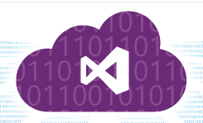

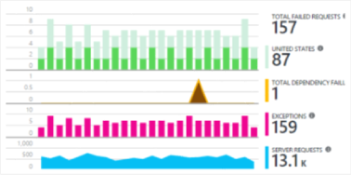


Agile Development on App Service
2) Code repository
3) Build
4) Deploy to stage
5) Validate
6) Publish
1) Develop
8) Monitor and improve
7) Deploy to cloud

Slide 15



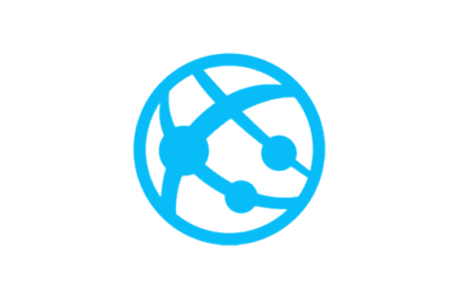
App Service Environment (ASE)
The apps in an ASE are exposed to the internet through a VIP
Because the apps are inside your VNet, they can access resources that are in the same virtual network without additional configuration.
If the VNet is connected to an on premises network via a Site to Site or ExpressRoute VPN then they can access resources on premises
If you want private site access then create an ILB ASE which uses an Internal Load Balancer instead of one with an external VIP
An ASE is a deployment of the Azure App Service into a subnet in a customer’s Azure Virtual Network (VNet)
Internet
Azure Virtual Network
VIP
On Premises
App Service Environment
Site to Site or ExpressRoute VPN

Slide 16
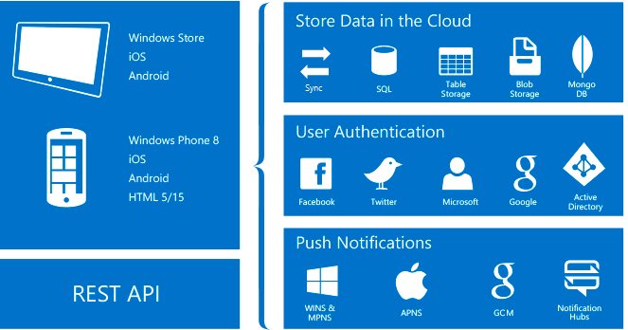
Mobile Apps
A highly scalable, globally available mobile application development platform

Slide 17
API Apps Features
Easy consumption
Integrated Support for Swagger Metadata
Simple access control
AAD, Facebook, Twitter, Google, Microsoft Account
Visual Studio integration
Integration with Logic Apps
Bring your existing API as-is
Notes:
Easier to build, host, and consume APIs in the cloud and on-premises.
Enterprise grade security, simple access control, hybrid connectivity, automatic SDK generation, and seamless integration with Logic Apps.

Slide 18
Logic Apps Features
Workflow
Model business process as series of steps or a workflow
Managed APIs
Access common services like Azure Blob, Dropbox, Facebook, Office 365, Salesforce, and many, many more
Triggers
Managed APIs can kick off the workflow by triggering on specific events
Actions
Steps in the workflow where the data is enriched, transformed, etc.
BizTalk
Validation, transformation, rules, etc.
Notes:
Logic Apps allow developers to design workflows that start from a trigger and then execute a series of steps.
Each step invokes an API whilst securely taking care of authentication and best practices, like checkpointing and durable execution.

Slide 19
Azure functions architecture
Built on top of App Service and WebJobs SDK
Code
Config
Language Runtime C#, Node.js, F#, PHP, etc.
WebJobs Script Runtime Azure Functions Host – Dynamic Compilation, Language abstractions, etc.
WebJobs Core
Programming model, common abstractions
WebJobs Extensions
Triggers, input and output bindings
App Service Dynamic Runtime Hosting, CI, Deployment Slots, Remote Debugging, etc.

Slide 20
Azure functions
Make composing Cloud Apps easy
Develop Functions in C#, Node.js, F#, Python, PHP, Batch, and more
Easily schedule event-driven tasks across services
Expose functions as HTTP API endpoints
Scale functions based on customer demand
Easily integrate with Logic Apps

Slide 21
App Service Environment (ASE)
Fully isolated and dedicated environment for Web Apps, Mobile Apps, and API Apps
Virtual Network support (v1)
Support Site-to-Site VPN and ExpressRoute
Composed of:
A front-end resource pool for SSL termination and load balancing
One to three worker compute resource pools

Slide 22
Service Fabric

Slide 23
Microsoft Azure Service Fabric
A platform for reliable, hyperscale, microservice-based applications
Microservices
High Availability
Data Partitioning
Service Fabric
Health Monitoring
Container Orchestration & lifecycle management
Hybrid Operations
Self-healing
Simple programming models
High Density
Rolling Upgrades
Low Latency
Placement Constraints
Replication & Failover
Stateful services
Fast startup & shutdown
Resource balancing
Hyper-Scale
Automated Rollback
Windows
Server
Linux
Windows
Server
Linux
Azure
Hosted Clouds
Windows
Server
Linux
Private Clouds
Notes:
Microsoft Azure has been going through the transition of taking Tier 1 products such as SQL Server, Analysis Server, System center, Lync and running these as cloud services, as well as creating brand new “born in the cloud” Tier 1 services such as DocumentDB. In order to do this, we needed a new kind of PaaS, one that provides all the capabilities shown here such as high availability at scale, running at high density to reduce costs, agility in large development teams to be able to decompose the cloud service down into independent discrete smaller services each of which be partitioned for scale.
Importantly, we realized that the largest cost for a cloud service was the day to day management and operation of the service, and not having to worry about the availability of the service in the event of machine, network, process failures. So, Service Fabric also provides a self-healing approach which means you do not need large teams of people to ensure that the service is always running. Equally with the concepts of application versioning, no downtime rolling upgrades and automatic service resource balancing based on current load and health, Service Fabric provides complete lifecycle support for your cloud service.
Service Fabric will be available in Azure as a service and in Windows Server 2016. Applications built against the programming APIs can be deployed to any of these environments with no code changes. Currently, as you would expect given that we developed Service Fabric for our own services, it runs on Windows, but we have started the port on Linux that we will eventually release.
The world is changing for you as developers, as previous on-premises products move the cloud as services to take advantage of utility computing and global reach. You need a platform that helps get you there. Now you can use the same platform that Azure is using for its tier 1 services and all this is installed on your laptop. You have a whole datacenter in your hands.
*****************************************************************************
Service Fabric is a proven distributed systems platform that:
Makes it easy to build scalable and reliable services
Allows keeping compute and associated state together to achieve high throughput and low latency
Manages full service lifecycle
Can be deployed in-cloud or on-premises

Slide 24
Services built with Service Fabric
Skype for Business
Hybrid Ops
Azure Document DB
Billions transactions/week
Intune
800k devices
Azure Core Infrastructure
Thousands of machines
Event Hubs
20bn events/day
Bing Cortana
500m evals/sec
Azure SQL Database
1.4 million databases
Power BI
IoT Suite

Slide 25


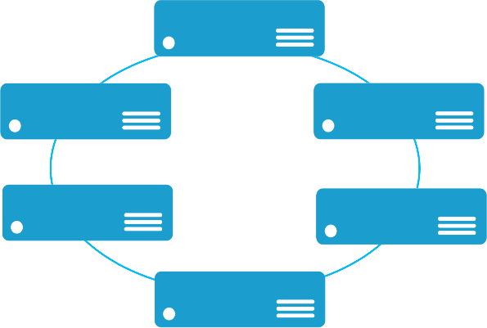


Monolithic application approach
Microservices application approach
App 1
App 1
App 2
A monolith app contains domain specific functionality and is normally divided by functional layers such as web, business, and data
Scales by cloning the app on multiple servers/VMs/containers
A microservice application separates functionality into separate smaller services
Scales out by deploying each service independently creating instances of these services across servers/VMs/containers
Notes:
Increase business value
Shorter time to market
No monolithic services
Version services independently
DevOps boundaries blurred

Slide 26
Azure SQL Database

Slide 27
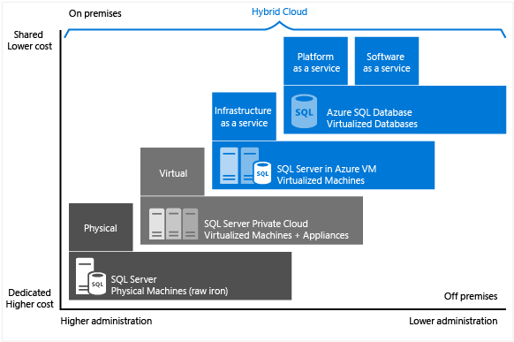
Azure SQL Database
Fully managed SQL database service
Built for SaaS and Enterprise applications
Predictable performance and pricing
Elastic database pool for unpredictable SaaS workloads
99.99% availability built-in
Geo-replication and restore services for data protection
Secure and compliant for your sensitive data
Fully compatible with SQL Server 2014 databases
Performance measured as DTU

Slide 28
SQL Database vs. SQL Server on Azure VM
SQL Database | SQL Server on Azure VM
New cloud-designed applications that have time constraints in development and marketing Applications that need built-in high availability, disaster recovery, and upgrade mechanisms Teams that do not want to manage the underlying operating system and configuration settings Applications using scale-out patterns Databases of up to 4 TB in size Building Software-as-a-Service (SaaS) applications | Existing applications that require fast migration to the cloud with minimal changes SQL Server applications that require access to on-premises resources (such as Active Directory) from Azure via a secure tunnel If you need a customized IT environment with full administrative rights Rapid development and test scenarios when you do not want to buy on-premises non-production SQL Server hardware Disaster recovery for on-premises SQL Server applications or AlwaysOn replicas with Azure VMs
Notes:
This slide is informational and for learning purposes. You can reveal if a question comes up on this.

Slide 29
Database service tiers
Basic
Standard
Premium
Intended Use
Light transactional workloads
Go-to option for most business applications
High throughput and business-critical databases
Performance
•
••
•••
Workload Elasticity
Isolated databases and elastic database pools
Programming Surface
Fully compatible with SQL Server 2014 databases
Availability
99.99%*
Notes:
This slide is informational and for learning purposes. You can reveal if a question comes up on this.

Slide 30
Securing Azure SQL Database
Connection security
Authentication
SQL and AAD
Authorization
Database roles
Permissions
Row-level security
Data masking
Encryption
TDE
Cell-level encryption
Always encrypted
Auditing
Firewall
Notes:
Great reference
https://docs.microsoft.com/en-us/azure/security/azure-security-services-technologies#azure-database-security

Slide 31
Azure Container Services

Slide 32
Azure Container Service
A platform for reliable, hyperscale, container-based applications
Microservices
Flexible programming models
Open Source Orchestration
Azure Container Service
Host cluster management
Container hosts as cattle
Hyper-Scale
High Availability
High Availability
High Density
Open Source Container Management
Placement Constraints
Fast startup & shutdown
Self-healing
Azure
Private cloud
Other clouds

Slide 33
What is a container?
Encapsulates a scenario
Are developed by a small engineering team
Can be written in any language and framework
Contain code plus state that is independently versioned, deployed, and scaled
Interact with other microservices over well-defined interfaces and protocols such as http

Slide 34
App A
App A’
App B
Containers are isolated, but share OS and, where appropriate, bins/libraries
Bins/Libs
Bins/Libs
Bins/Libs
Guest OS
Guest OS
Guest OS
App A
App A’
App B
App B’
App B
App B’
App B
App B’
Bins/Libs
Bins/Libs
Hypervisor
Docker Engine
Host OS
Host OS
Server
Server

Slide 35
Notification Hubs

Slide 36
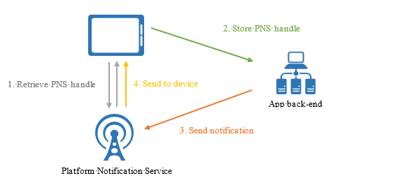
Notification Hubs
At a high level, all platform notification systems follow the same pattern:
The client app contacts the PNS to retrieve its handle. The handle type depends on the system. For WNS, it is a URI or "notification channel." For APNS, it is a token.
The client app stores this handle in the app back-end for later usage. For WNS, the back-end is typically a cloud service. For Apple, the system is called a provider.
To send a push notification, the app back-end contacts the PNS using the handle to target a specific client app instance.
The PNS forwards the notification to the device specified by the handle.

Slide 37
Batch

Slide 38
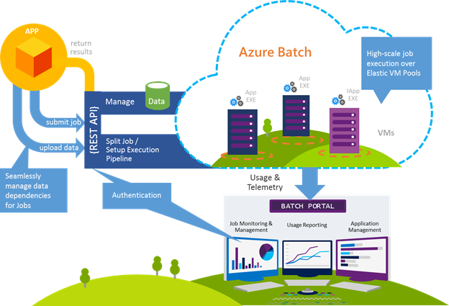
Azure Batch
Azure Batch is a service offering that came later in the platform evolution and offers a similar type service, but with a unique twist.
It has been designed to run background processes but more centered around Big Data and high performance data.
Azure Batch is comprised of two primary components
Azure Batch and Azure Batch Apps
Azure batch APIs focus on the ability to create pools of Virtual Machines and define work artifacts (work items) that will be scheduled for processing

Slide 39
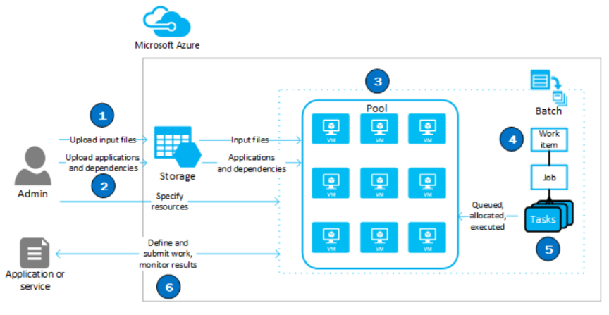
Azure Batch models
Consider Azure batch for workloads in which an existing process or executable is used to process the data
To maximize effectiveness, the data should be in a format that can allow parallelization (cut the data in several chunks)
Azure Batch: Create pools of VMs and define work artifacts (work items) that will be schedule for processing. Azure Batch brings with it an API to support the infrastructure. No need to manually build servers and software libraries to handle job scheduling.
Azure Batch Apps: Azure Batch Apps take Azure Batch a step further. The goal is to publish an “app” that is essentially a service that will allow data to be fed to it, and it will run as needed. New ability to monitor the jobs through the portal and REST APIs is provided.

Slide 40
Redis Cache

Slide 41
Redis Cache features
Low latency, high throughput key-value store
Per Key expiry, choice of eviction policies
Atomic operations on data types
Strings, hashes, lists, sets, sorted sets, bitmaps and hyperloglogs
Transactions
Publisher-subscriber pattern
LUA scripting
Pipelining
Client libraries in multiple languages
Notes:
Redis has many different use cases. The simplest way to describe it is something between a traditional database and doing computations in memory. Redis exposes data structures that are accessed in memory via a set of commands
More than a Cache
FEATURES
Databases
Highly customizable replication support
Persistence support – Snapshot for backup and restore
Point in time, log every write, or both
Clustering

Slide 42
Azure Redis Cache
Open source Redis hosted and managed by Microsoft
Dedicated Virtual Machine per cache
Sizes – 256 MB-530 GB (contact us for more)
Available in all Azure Regions – China and US Govt.
SSL
Basic SKU – Single cache node
Standard SKU – Cache node + one replica (SLA 99.9%)
Premium tier – Highest performance, Redis data persistence, Redis cluster, Azure Virtual Network support

Slide 43
Scaling Azure Redis Cache
Scale up – AKA vertical scaling
Increased Cache size (memory)
Increased bandwidth
Single CPU
Scale out – AKA horizontal scaling
Increased Cache size, bandwidth, CPU
Improved availability
Sharding available in Premium SKU

Slide 44
Cosmos DB
aka.ms/Azure/Cosmos
Notes:
NOTE: to prepare or learn this, watch https://channel9.msdn.com/Events/Ignite/Microsoft-Ignite-Orlando-2017/BRK3086
Also read https://aka.ms/Azure/Cosmos
Any web, mobile, gaming, and IoT application that needs to handle massive amounts of data, reads, and writes at a global scale with near-real response times for a variety of data will benefit from Azure Cosmos DB's guaranteed high availability, high throughput, low latency, and tunable consistency. Learn about how Azure Cosmos DB can be applied to IoT and telematics, Retail and marketing, Gaming and Web and mobile applications.

Slide 45
Introducing Azure Cosmos DB A globally distributed, massively scalable, multi-model database service
Automatically replicate all your data around the world – across more regions than Amazon and Google combined
Global distribution
Notes:
Azure Cosmos DB is Microsoft's globally distributed, multi-model database. With the click of a button, Azure Cosmos DB enables you to elastically and independently scale throughput and storage across any number of Azure's geographic regions. It offers throughput, latency, availability, and consistency guarantees with comprehensive service level agreements (SLAs), something no other database service can offer. You can Try Azure Cosmos DB for free without an Azure subscription, free of charge and commitments.

Slide 46
Introducing Azure Cosmos DB A globally distributed, massively scalable, multi-model database service
Use key-value, graph, and document with a schema-agnostic service that doesn’t require any schema or secondary indexes
Global distribution
Multi-model + multi API
KEY-VALUE
COLUMN-FAMILY
DOCUMENT
GRAPH

Slide 47


Introducing Azure Cosmos DB A globally distributed, massively scalable, multi-model database service
Independently and elastically scale storage and throughput across regions
Global distribution
Multi-model + multi API
Elastic scale-out

Slide 48
Introducing Azure Cosmos DB A globally distributed, massively scalable, multi-model database service
Choose from five defined consistency levels for low latency and high availability
Global distribution
Multi-model + multi API
Elastic scale-out
Strong
Bounded-stateless
Session
Consistent prefix
Eventual
Choice of consistency

Slide 49
Introducing Azure Cosmos DB A globally distributed, massively scalable, multi-model database service
Serve <10 ms read and <15 ms write requests at the 99th percentile from the nearest region while delivering data globally
Global distribution
Multi-model + multi API
Elastic scale-out
Guaranteed global millisecond latency at the 99th percentile
Choice of consistency
Guaranteed single-digit latency

Slide 50
Introducing Azure Cosmos DB A globally distributed, massively scalable, multi-model database service
Only service with financially-backed SLAs for millisecond latency at the 99th percentile, 99.99% HA and guaranteed throughput and consistency
Global distribution
Multi-model + multi API
Latency
Throughput
Elastic scale-out
<10ms
HA
Consistency
Guaranteed
Choice of consistency
99th percentile
99.99%
Guaranteed
Guaranteed single-digit latency
Enterprise-level SLAs
Notes:
Only service with financially-backed SLAs for millisecond latency at the 99th percentile, 99.99% HA and guaranteed throughput and consistency
Text was: Access leading SLAs for latency at the 99th percentile, 99.99% HA, guaranteed throughput and consistency

Slide 51
Azure Search
aka.ms/Azure/Search
Notes:
http://aka.ms/Azure/Search
Azure Search is a search-as-a-service cloud solution that gives developers APIs and tools for adding a rich search experience over your content in web, mobile, and enterprise applications.
Functionality is exposed through a simple REST API or .NET SDK that masks the inherent complexity of information retrieval. In addition to APIs, the Azure portal provides administration and content management support, with tools for prototyping and querying your indexes. Because the service runs in the cloud, infrastructure and availability are managed by Microsoft.
Among cloud providers, Azure Search is strongest for full text search workloads over content stores and databases on Azure, for apps that rely primarily on search for both information retrieval and content navigation. Key strengths include:
Azure data integration (crawlers) at the indexing layer
Azure portal for central management
Azure scale, reliability, and world-class availability
Linguistic and custom analysis, with analyzers for solid full text search in 56 languages
Core features common to search-centric apps: scoring, faceting, suggestions, synonyms, geo-search, and more.
Among our customers, those able to leverage the widest range of features in Azure Search include online catalogs, line-of-business programs, and document discovery applications.

Slide 52
Azure Search overview
Embed a sophisticated search experience in web and mobile applications without worrying about the complexities of full-text search and without deploying, maintaining, or managing any infrastructure.
Perfect for enterprise cloud developers, cloud-software vendors, or cloud architects who need a fully-managed search solution.
Build a sophisticated search experience
Reduce friction and complexity
Differentiate your application
Powerful, guaranteed performance
Sophisticated search
Connects business goals to the application
Simplify search-index management
Set up and scale out easily
Integrate data seamlessly
Fast time to market
Backed by Microsoft Azure
Notes:
So, what is Azure Search?
Azure Search is a fully managed search solution that allows developers to enable search in web and mobile applications by embedding a sophisticated search experience into these applications without having to worry about the complexities of full-text search and without having to deploy, maintain, or manage any infrastructure.
There are three main points to Azure Search:
First, Azure Search enables developers to surface their application’s data. We provide all the features that you would expect from sophisticated search solutions and provide reliable, guaranteed performance on top of that. The tunable ranking models built into Azure Search allows developers to tie search results to their business objectives by promoting results that they want to show up. For example, if you have an e-commerce site, you want high-margin items to come up higher in the search results than low-margin items.
Second, Azure Search reduces complexity. It’s a fully managed service, so we’re removing the need to worry about corrupt indexes, managing and upgrading hardware, and scaling out. You can easily scale out Azure Search to handle additional storage or throughput when that’s called for by business conditions, such as during a peak shopping season or if your app is featured in the news and traffic increases dramatically.
Third, Azure Search allows developers to move quickly with confidence. As the name implies, Azure Search runs on Azure. It’s available in the new portal, which is all about being able to get up and running quickly and having lots of complementary services nearby. Also, you control Azure Search by using an API that makes it easy and familiar to manage.
These benefits all support the claim that Azure Search is perfect for enterprise cloud developers, cloud-software vendors, and cloud architects who need a fully-managed search solution.

Slide 53
Capabilities summary
Simple HTTP/JSON API for managing and using the entire service
Core search functionality
Keyword search with user-friendly operators (such as +, -, *, and “”)
Phonetic, Synonym and regex search
Hit highlighting
Faceting & Filtering
Suggestions (auto-complete), including infix matching and fuzzy matching
Rich structured queries (filter, select, and sort) that combine with search
Integration with external data sources
Broad language support with rich linguistics
Scoring profiles to model search-result relevance
Geo-spatial support integrated into filtering, sorting, and ranking
Elastic scale and high availability

Slide 54
HDInsight
aka.ms/Azure/HDInsight
Notes:
http://aka.ms/Azure/HDInsight

Slide 55
Azure HDInsight
A Cloud Spark and Hadoop service for the Enterprise
Reliable with an industry leading SLA
Enterprise-grade security and monitoring
Productive platform for developers and scientists
Cost effective cloud scale
Integration with leading ISV applications
Easy for administrators to manage
63% lower TCO than deploy your own Hadoop on-premises*
*IDC study “The Business Value and TCO Advantage of Apache Hadoop in the Cloud with Microsoft Azure HDInsight”
Notes:
Reliable Open Source analytics with an Industry leading SLA
HDInsight allows you to easily spin up enterprise-grade open source cluster types guaranteed with the industry’s best 99.9% SLA and 24/7 support. We guarantee this SLA for the entire big data solution, not just the VM instances. HDInsight is architected for full redundancy and high availability including head node replication, data geo-replication, and built-in standby NameNode making HDInsight resilient to critical failures not addressed in standard Hadoop implementations. Azure also offers cluster monitoring and 24x7 enterprise support backed by Microsoft and Hortonworks with 37 combined committers for Hadoop core, more than all other managed cloud providers combined to support your deployment and the ability to fix and commit code back to Hadoop.
Enterprise Grade Security & Monitoring
HDInsight protects your data assets and easily extends your on-premise security and governance controls to the cloud. We feature single sign-on (SSO), multi-factor authentication and seamless management of millions of identities through Azure Active Directory. You can authorize users and groups with fine-grained access control policies over all your enterprise data with Apache Ranger. HDInsight meets HIPAA, PCI, SOC compliance, ensuring your enterprise data assets are always protected with the highest security and regulatory compliance. To ensure the highest level of business continuity, HDInsight extends capabilities for alerting, monitoring, defining pre-emptive actions, and enhanced workload protection through native integration with Azure Operations Management Suite (OMS).
Most Productive platform for developers and scientists
HDInsight offers developers tailored experiences through rich productivity suites for Hadoop & Spark with integrated development environments using Visual Studio, Eclipse, and IntelliJ supporting Scala, Python, R, Java, and .Net. HDInsight gives data scientists the ability to create narratives that combine code, statistical equations, and visualizations that tell a story about the data through integration to the two most popular notebooks: Jupyter and Zeppelin. HDInsight is also the only managed cloud Hadoop solution with integration to Microsoft R Server. Multi-threaded math libraries and transparent parallelization in R Server means handling up to 1000x more data and up to 50x faster speeds than open source R—helping you train more accurate models for better predictions than previously possible.
Cost effective cloud scale
HDInsight has decoupled compute and storage, enabling you to cost-effectively scale workloads up or down, independent of storage. Local storage can still be used for caching and fast I/O. Spark and interactive Hive users can choose SSD memory for interactive performance; while Kafka users can retain all streaming data in premium managed disks. You only pay for the compute and storage you use and are given the ability to choose any Azure VM types that enables the best utilization of resources. A recent study showed HDInsight delivering 63% lower TCO than deploying Hadoop on premises over 5 years.*
Integration with leading Productivity Applications
In the broader ecosystem for Hadoop, there is a thriving market of independent software vendors (ISVs) who provide value added solutions. Through a unique design where every cluster is extended with edge nodes and script action, HDInsight lets customers spin up Hadoop and Spark clusters pre-integrated and pre-tuned with any ISV application out-of-the-box. Datameer, Cask, AtScale, StreamSets are few such applications, which are very popular on the HDInsight platform today.
Easy for administrators to manage
With HDInsight, administrators can deploy Hadoop in the cloud without buying new hardware or incurring other up-front costs. There’s also no time-consuming installation or set up. There is also no need to patch the operating system or upgrade the Hadoop versions. Azure does it for you. Launch your first cluster in minutes.

Slide 56







HDInsight – What is it?
A standard Apache Hadoop distribution offered as a managed service on Microsoft Azure
Based on the Hortonworks Data Platform (HDP)
Provisioned as clusters on Azure. Clusters can run on Windows or Linux Servers.
Offers a capacity-on-demand, pay-as-you-go pricing model
Integrates with:
Azure Blob Storage and Azure Data Lake Store for the Hadoop File System (HDFS)
Azure Portal for management and administration
Visual Studio for application development tooling
In addition to the core, HDInsight supports the Hadoop Ecosystem
Hive

Slide 57


HDInsight Storm
Stream analytics for near-real time processing
Consumes millions of real-time events from a scalable event broker (ie. Apache Kafka, Azure Event Hub)
Performs time-sensitive computation
Output to persistent stores, dashboards, or devices
Customizable with Java + .NET
Deeply integrated to Visual Studio
Event producers
Collection
Event Queuing System
Transformation
Long-term storage
Presentation and action
Apache Storm on HDInsight
Kafka /
RabbitMQ /
ActiveMQ
HBase
Web/thick client dashboards
Applications
HDFS
Azure DBs
Search and query
Event Hubs
Azure Stream Analytics
Devices
Cloud gateways (web APIs)
Stream processing
Azure storage
Sensors
Live Dashboards
Data analytics (Excel)
Field gateways
Storage adapters
Devices to take action
Web and Social

Slide 58
Machine Learning
aka.ms/Azure/ML

Slide 59
Azure Machine Learning Services - Overview
AZURE MACHINE LEARNING SERVICES
TRAIN & DEPLOY OPTIONS
Spark
SQL Server
Virtual machines
GPUs
Container services
AZURE
AI dev /
data scientist
workstation
CPU/GPU
ON-PREMISES
SQL Server
Machine Learning Server
Experimentation and Model Management
Notebooks
Azure Machine Learning Workbench
Visual Studio Code Tools for AI
Visual Studio Tools for AI
PyCharm
EDGE COMPUTING
Azure IoT Edge

Slide 60

Experimentation Services
Local machine
Scale up to DSVM
Command line tools
IDEs
Scale out with Spark on HDInsight
Notebooks in Workbench
VS Code Tools for AI
VS Tools for AI
AZURE ML
EXPERIMENTATION
Azure Batch AI (Coming Soon)
ML Server (Coming Soon)

Slide 61

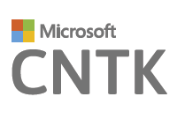
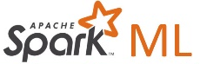

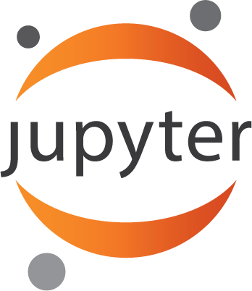




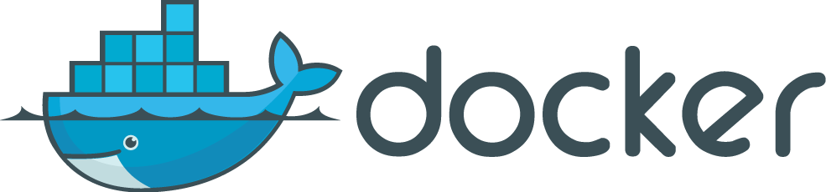

Experimentation service
Manage project dependencies
Orchestrate training jobs locally, scaled-up (VM) or scaled-out (HDInsight)
Git based checkpointing and version control
Service side capture of run metrics, output logs and models
Use your favorite IDE, and any framework
Use any framework or library
Use any tool
Use the most popular innovations

Slide 62
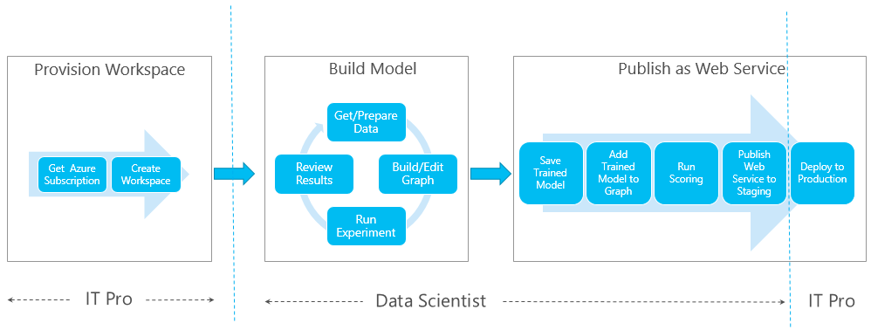
Azure Machine Learning Model
Toolset to create Azure ML experiments include the Azure Machine Learning Studio
An experiment consists of dragging components to a canvas, and connecting them in order to create a model, train the model, and score and test the model
The experiment uses predictive modeling techniques in the form of Machine Learning Studio modules that ingest data, train a model against it, and apply the model to new data
You can also add modules to preprocess data and select features, split data into training and test sets, and evaluate or cross-validate the quality of your model

Slide 63
Stream Analytics

Slide 64
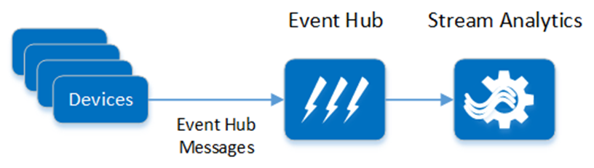
Stream Analytics
Stream Analytics is a real-time stream processing service used to uncover insights from devices, sensors, infrastructure, and applications. Streaming millions of events per second, stream analytics can be used to perform real-time analytics for IoT solutions. Developers can describe their desired event stream processing and transformations using a SQL-like query language. The system abstracts the complexities of the parallelization, distributed computing, and error handling.

Slide 65
Data Factory

Slide 66
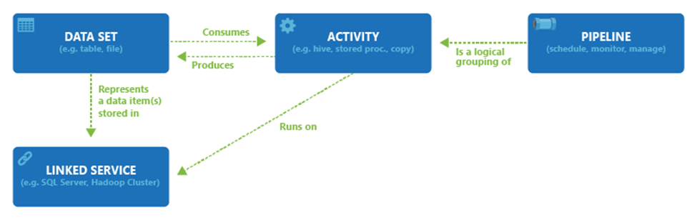
Azure Data Factory
Azure Data Factory is a cloud-based data integration service that orchestrates and automates the movement and transformation of data. It orchestrates existing services that collect raw data and transform it into ready-to-use information. ADF is used to collect data from many different on-premises data sources, ingest and prepare it, organize and analyze it with a range of transformations, then publish ready-to-use data for consumption. Beyond orchestrating the flow of a data pipeline, ADF offers a single unified view to easily pinpoint issues and setup monitoring alerts.

Slide 67
Azure Data Lake

Slide 68
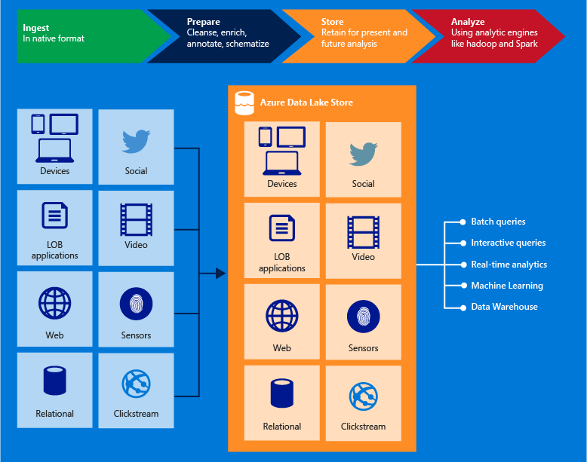
Data Lake Store
Azure Data Lake Store is an enterprise-wide hyper-scale repository for big data analytic workloads. Azure Data Lake enables you to capture data of any size, type, and ingestion speed in one single place for operational and exploratory analytics.

Slide 69
Azure Data Lake Analytics

Slide 70
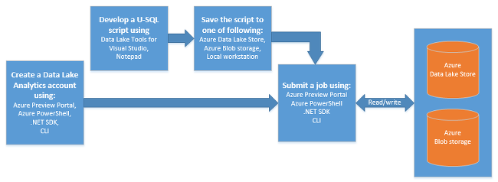
Data Lake Analytics
Azure Data Lake Analytics is a new service, built to make big data analytics easy. This service lets you focus on writing, running and managing jobs, rather than operating distributed infrastructure. Instead of deploying, configuring and tuning hardware, you write queries to transform your data and extract valuable insights. The analytics service can handle jobs of any scale instantly by simply setting the dial for how much power you need. You only pay for your job when it is running making it cost-effective.

Slide 71
Azure IoT Hub

Slide 72
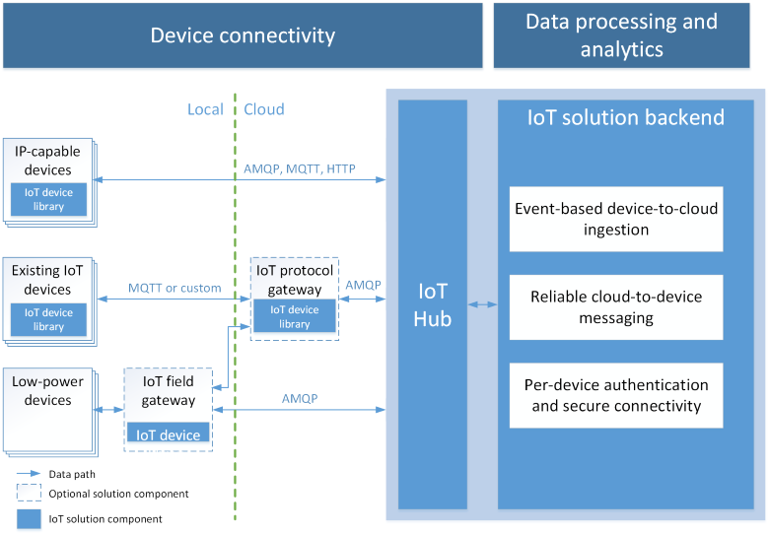
IoT Hub
Azure IoT Hub is a fully managed service that enables reliable and secure bidirectional communications between millions of IoT devices and a solution back-end. Azure IoT Hub:
Provides reliable device-to-cloud and cloud-to-device messaging at scale
Enables secure communications using per-device security credentials and access control
Provides extensive monitoring for device connectivity and device identity management events
Includes device libraries for the most popular languages and platforms

Slide 73
Event Hubs

Slide 74
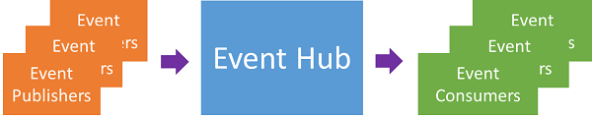
Event Hubs
An event processing service
Provides event and telemetry ingress to the cloud
Massive scale, Low latency and High reliability.
Scenarios
application instrumentation
user experience or workflow processing
Internet of Things (IoT)
How Azure Event Hub capabilities differ from Service Bus topics
they are strongly biased towards high throughput and event processing scenarios.
Notes:
Azure Event Hub is an event processing service that provides event and telemetry ingress to the cloud at massive scale, with low latency and high reliability. This service, used with other downstream services, is particularly useful in application instrumentation, user experience or workflow processing, and Internet of Things (IoT) scenarios. Event Hub provides a message stream handling capability and, though an Event Hub is an entity similar to queues and topics, it has characteristics that are very different from traditional enterprise messaging.
Enterprise messaging scenarios commonly require a number of sophisticated capabilities such as sequencing, dead-lettering, transaction support, and strong delivery assurances, while the dominant concern for event intake is high throughput and processing flexibility for event streams. Therefore, Azure Event Hub capabilities differ from Service Bus topics in that they are strongly biased towards high throughput and event processing scenarios.

Slide 75
Media Services

Slide 76
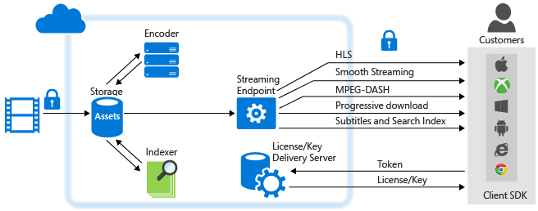
Media Services
Microsoft Azure Media Services is an extensible cloud-based platform that enables developers to build scalable media management and delivery applications. Media Services is based on REST APIs that enable you to securely upload, store, encode and package video or audio content for both on-demand and live streaming delivery to various clients (for example, TV, PC, and mobile devices).
You can build end-to-end workflows using entirely Media Services. You can also choose to use third-party components for some parts of your workflow. For example, encode using a third-party encoder. Then, upload, protect, package, deliver using Media Services.
You can choose to stream your content live or deliver content on demand.

Slide 77
Content Delivery Network

Slide 78
Content Delivery Network
CDN networks are used for static content such as media, images, or documents which are read more than written to. The end goal being to push content to areas of the world where users are located.
Speed
Reliability
Efficiency
In almost every case, content utilizing a CDN will be much closer to the end-user, resulting in faster delivery and a better user experience
The CDN spreads out content, replicating that content across the globe, resulting in reduced demand on any given server
The CDN optimizes for delivery, allowing the customer to focus on the quality of their content, not on the delivery of that content

Slide 79
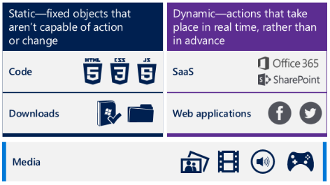
Content Delivery Network model
Azure’s CDN is a network of severs deployed in multiple datacenters across the Internet that can get your content from where you are to where your customers are consuming more quickly than the Internet alone.
Typically, CDN networks are used for static content such as media, images, or documents which are read more than written to. The following are examples:

Slide 80
Storage Queues

Slide 81
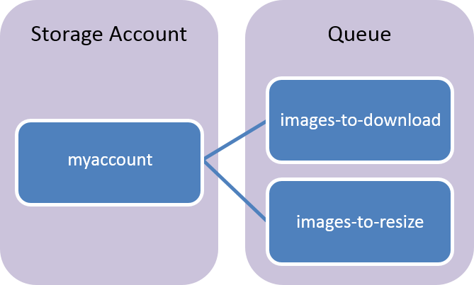
Storage Queues
Azure Queue storage is a service for storing large numbers of messages that can be accessed from anywhere in the world via authenticated calls using HTTP or HTTPS. A single queue message can be up to 64 KB in size, and a queue can contain millions of messages, up to the total capacity limit of a storage account.
Common uses of Queue storage include:
Temporary message storage to be processed asynchronously
Passing messages between application components/tiers
If larger messages, pub/sub, brokered messages, etc. are a requirement, then look at Service Bus.

Slide 82
Relay Hybrid Connections

Slide 83
Relay Hybrid Connections
The Relay Hybrid Connections relay connects two parties by providing a rendezvous point in the Azure cloud that both parties can discover and connect to from their own network’s perspective.
There is a listener that first indicates readiness to handle incoming connections, and subsequently accepts them as they arrive. On the other side, there is a connecting client that connects towards the listener, expecting that connection to be accepted for establishing a bi-directional communication path. "Connect," "Listen," and "Accept" are the same terms you will find on most socket APIs.
Relay Hybrid Connection supersedes the former, equally named "BizTalk Services" feature that was built on a proprietary protocol foundation. The integration of Hybrid Connections into Azure App Services will continue to function as-is.
Notes:
The Azure Relay service facilitates hybrid applications by enabling you to securely expose services that reside within a corporate enterprise network to the public cloud, without having to open a firewall connection, or require intrusive changes to a corporate network infrastructure. Relay supports a variety of different transport protocols and web services standards.
Azure Relay has two features:
Hybrid Connections – Uses the open standard web sockets enabling multi-platform scenarios
WCF Relays – Uses Windows Communication Foundation (WCF) to enable remote procedure calls. WCF Relay is the legacy Relay offering that many customers may already use with their WCF programming models

Slide 84
Service Bus

Slide 85
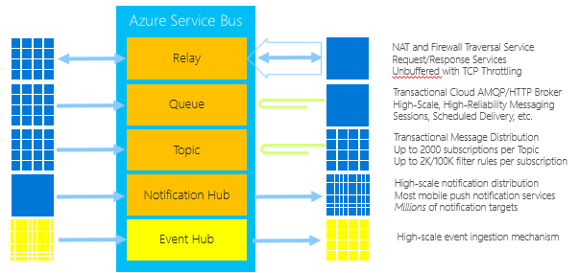
Azure Service Bus
Service bus is a high performance, durable messaging service for queueing, as well as relay services.

Slide 86
Azure Service Bus
Service Bus queues are used to provide an option to decouple any processing from the request pipelines
Consider these types of architectures, especially when migrating workloads to the cloud as loosely coupled applications can scale and are more fault resilient than the counter
Use Service Bus with a variety of models from simple queues based storage, to topics, which target and partition messages in a namespace. Consider using Event Hubs on top of Service Bus to service very large client bases, where inputs to the bus will include several thousands to millions in rapid succession

Slide 87
Takeaways
What PaaS Services are you considering or using now?
Any particular areas you would like to focus more on?
Follow up questions
Additional resources for learning needed?
Are there any limits that may constrain your deployments?
Aka.ms/Azure/Limits
Next Steps
Notes:
SPEAKER NOTES
The goal is to summarize what areas of interest that have been sparked by reviewing these topics
Are there any follow up questions or resources needed?

Slide 89
How to use Appendix
These are “extra” slides
Use to enhance your learning
Can reference to show if other slides do not explain what the customer wants to see
Use this section also to reduce the total number of slides to present by moving extra slides here
DELETE THIS SLIDE BEFORE DELIVERY

Slide 90
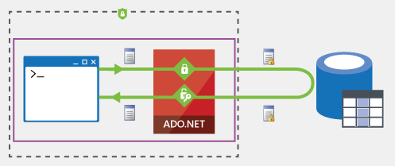

SQL encryption “Always encrypted”
plaintext
ciphertext
Removes the database from the attack surface area
Sensitive data encrypted in the database at all times
Even DBAs and sys admins cannot access the data in SQL Server/Azure SQL Database
Enables customers to host their databases outside of a trust/compliance boundary:
In the cloud (Azure SQL Database)
In a different geo-political region
Encrypted data can be queried (equality comparison)
Encryption is transparent to client applications

Slide 91
SQL encryption Transparent Data Encryption (TDE)
Encrypting your database, associated backups, and transaction log files at rest
No changes to your application
Supported for both SQL Server and SQL Azure (IaaS, Paas)
Can use Azure Key Vault for key storage

Slide 92
SQL encryption
Product | Encryption class | Key management | Feature name
SQL Server (IaaS) | Client-side | Customer-managed | Always Encrypted
SQL Server (IaaS) | Server-side | Customer-managed | SQL Connector for AKV
Azure SQL DB (PaaS) | Client-side | Customer-managed | Always Encrypted
Azure SQL DB (PaaS) | Server-side | Service-managed | TDE for Azure SQL DB
Azure SQL DB (PaaS) | Server-side | Customer-managed | TDE for Azure SQL DB with AKV

Slide 93
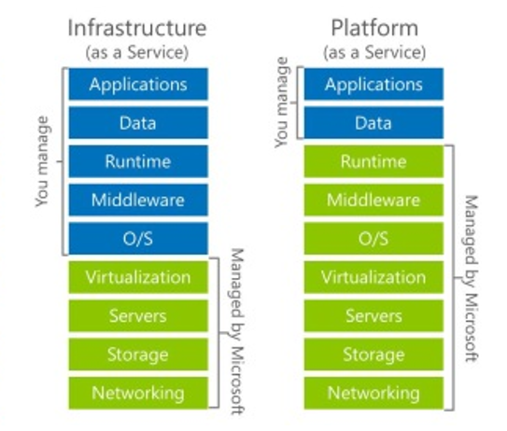
Compute IaaS and PaaS
Many organizations require a transition to adopt a fully outsourced model
Lines of division between IaaS and PaaS responsibilities are blurred in applications that use both constructs
While PaaS is typically the goal, IaaS is a current reality most workloads both require and understand for some functions
Notes:
Both Azure’s IaaS and PaaS capabilities and services can support a wide range of customer applications and services.
Cloud Infrastructures can be comprised of on-premises customer or partner hosted and publicly hosted cloud computing, thus allowing organizations to consume natively and across their models in a hybrid capacity.

Slide 94
How to decide?
Does app require third party components?
Do security requirements mandate the use of third party monitoring software?
Does app require specific framework configurations?
The more customization that is required, the more one moves towards IaaS and away from PaaS.

Slide 95
PaaS considerations
Understand tradeoffs and decision points on the following:
Upgrade domains
Deployment slots
Web deploy
Continuous integration
Deploy
Understand the methods of monitoring PaaS workloads:
IIS Logs
Azure Diagnostics
IIS Failed Request Logs
Windows Event Logs
Manage
Performance Counters
Crash Dumps
Custom Error Logs
.NET EventSource
Manifest based ETW
Application Insights
Auto scaling: The application environment does not automatically increase or decrease role instances for increase or decrease in load
Load balancing: Application instances not load balanced by default
Density: Service Management total cloud services per subscription is 20
Limits

Slide 96
PaaS investments on ARM and ASM

Slide 97
Compute options with ASM
IaaS
PaaS
on IaaS
Virtual
Machines
Cloud Services (Web/Worker Roles)
BRING YOUR VM
ELASTIC DECLARATIVE
Ultimate
control
Cost and
agility

Slide 98
PaaS options with ARM stack
VM Scale Sets
Azure Container Service
App Service
Service Fabric
Elastic and declarative
Open source high density
Web and mobile
Stateless and stateful
Infra Control
Lift-and-Shift
Hyper Scale
Micro Services

Slide 99
Key decision points – ASM/ARM
Recommendation – Use ARM for new and redeploy when possible
ARM benefits include:
Deploy, manage, and monitor services as a group
Templates
Define dependencies
RBAC
Tags
Many services can be deployed in either model
Compute, storage, and networking resources differ by model

Slide 100
Cloud Services

Slide 101
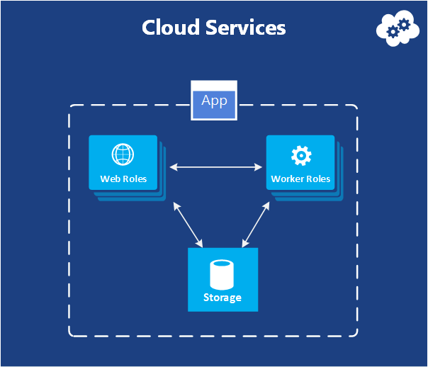
Cloud Services (classic/legacy)
Cloud Services (in the context of PaaS)
Units of deployment that contain the roles and instances, which comprise a given application
The cloud service will bind to the virtual IP (VIP) that services requests and load balance requests over underlying role instances

Slide 102
Cloud Services Model (classic/legacy)
It is best to understand what Cloud Services represent. At its simplest form, a Cloud Service is a container or package wrapper for applications that are deployed in Azure.
This cloud service model follows the traditional client application deployment model such as the appx format by modern Windows Applications
The target and core idea is to build, version, and deploy the service package unit (cloud service)
This makes it easier for the DevOps or release management team to deploy updates to the cloud service application, as well as rollback unforeseen side effects from an application update
Scaling cloud services in the PaaS model is trivial, as the application and service definition are both wrapped in a package
Deploying more instances is simply a matter of telling the Azure fabric how many instances you want

Slide 103
Cloud Services decisions (classic/legacy)
Recommended
Mandatory
Place all assets in cloud services, including code and other installations required to run the application. Everything must be included in the cloud service package and scripts installation.
Consider the deployment models that will be given when updating the application. There exist a few options, so it’s important to understand the pros and cons.
Optional
Consider the ability of multiple running deployment models for your cloud service. It’s possible to have multiple deployments in the form of production, test, and staging.

Slide 104
Web/Worker roles (classic/legacy) overview
Web/Worker a.k.a. Cloud Services is one of the top used Azure Services
Extensively used both by external and internal customers
Interesting stats about Cloud Service usage:
50-50 mix of web and worker roles
20% of cloud service VMs are in VNets
Average instances for top 20 external customers: 1599
Around 80% of external customers have less than 5 instances

Slide 105
Web and Worker roles (classic/legacy)
It’s important to remember that this type of PaaS application (Web and Worker roles) have dedicated underlying Virtual Machines per instance. Typically this is transparent, but it’s particularly important from a diagnostics perspective.
Application type | Description
Web role | This role is used primarily to host and support applications that target IIS and ASP.NET. The role will be provisioned out of the box with IIS installed and can be used to host front end web based applications.
Worker role | This role is used primarily to host and support service type applications. These applications target back-end processing workloads. These can be long running processes and can be thought of as Windows Services in the cloud.

Slide 106
Web and Worker roles model
Consider using Web and Worker roles as follows:
Web roles
Worker roles
Tailored for IIS based applications
Configure the scale unity for the instance and ensure that multiple (at least 2) are used for production workloads. Performed by setting the configuration in the service definition
Tailored for service type applications (non-web based)
As such, error handling that would be required for a “lights out” service type application should be employed.
If the exceptions are not handled in the service inner loop, the role instance will be restarted, causing downtime for processing

Slide 107
Web and Worker roles decisions (classic/legacy)
Recommended
Mandatory
Decide on the amount of instances for Web and Worker roles. Web and Worker roles require at least two instances to provide fault tolerance for the automatic maintenance nature of PaaS.
Consider Web and/or Worker roles if the application requires installation of binaries on the web or application server.
Optional
Understand that Virtual Networking is common to allow the communication needed for databases, management services, and other services but it’s not a hard requirement for deploying Web or Worker role applications.

Slide 108
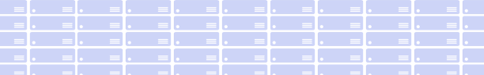
What do our customers love about Cloud Services?
Auto scaling
Auto OS update
Public/private peering
Manage Services, not servers
Custom plugins
Package and Deploy
Cloud Services and service fabric
App Lifecycle management
App Monitoring and Healing
Runtime Platform
ASM
Cloud Services
Dev
Infrastructure Services
Compute
Storage
Network
Azure Global Datacenters

Slide 109
What are the missing features?
Linux support
On-premises consistency
RBAC support
Automation and moving through DevOps is hard
Custom OS support
No flexibility for density
Implicit vendor lock-in
Runtime Platform
ASM
Cloud Services
Dev
Infrastructure Services
Compute
Storage
Network
Azure Global Datacenters

Slide 110
Web/Worker roles roadmap
We will continue to support Web/Worker Roles on ASM
Web/Worker Roles will co-exist with ARM resources
We will continue to expand new services (VM Scale Sets and Service Fabric) to fill the requirements of Web/Worker roles
For customers who want to leverage new functionality in ARM based PaaS options, we’ll provide transition assistance

Slide 111
Compute – Key decision points
Service name | Management | Peering (public, private, both) | Connectivity options (To on-prem resources)
Virtual Machines | ARM | Both | VNet(S2S, ER), Relay
VM Scale Sets | ARM | Both | VNet(S2S, ER), Relay
Cloud Services (Web/Worker) | ASM | Both | VNet(S2S, ER), Relay
Batch | ARM | - | Relay
Remote App¹ | ASM | Public | VNet(S2S, ER), Relay
Service Fabric | ARM | Both | VNet(S2S, ER), Relay
Container Service | ARM | Both | VNet(S2S, ER), Relay
¹ Remote App is being deprecated, see the following for more information: https://blogs.technet.microsoft.com/enterprisemobility/2016/08/12/application-remoting-and-the-cloud/

Slide 112
Compute – Key quotas, limits
Service name | Service level | Subscription level
Virtual Machines | 50 VMs/cloud service | Cores per Subscriptions: Default = 20, Max = 10000
VM Scale Sets | 100 VMs/scale set | 50 per region
Cloud Services (Web/Worker) | 25 roles/deployment | Default = 20; Max = 200
Batch | Jobs and Job Schedules: Default = 20, Max = 10000 | Account per Region/Sub: Default = 1; Max = 50
Remote App | - | -
Service Fabric | {See VM/VM Scale Sets, Storage, IP Addresses} | {See VM/VM Scale Sets, Storage, IP Addresses}
Container Service | {See VM/VM Scale Sets, Storage, Networking} | {See VM/VM Scale Sets, Storage, Networking}

Slide 113
Solution Alignment Workshop
All features and capabilities are shared across all of App Service application (Web, Mobile, and API)
Enterprise grade
Designed for secure mission-critical applications
Fully managed
Optimized for Availability and Automatic scale
Built for DevOps
Agility through Continuous Deployment
Premium Tier
App Service Environments
Hybrid Connections/Relay/VPN Support
Scheduled Backup
Azure Active Directory Integration
Site Resiliency, HA, and DR
Role Base Access Control
Audit/Compliance
Enterprise Migration
Client Certs
IP Restrictions/SSL
Dedicated IP address IP/NSG
Web Sockets
WW Datacenter Coverage
Automated Deployment AutoScale
Built-in Load Balancing
WW Datacenter Coverage
End Point Monitoring & Alerts
WildCard Support
HTTP Compression
WebJobs
Sticky Sessions
OS and Framework Patching
Auto-Healing
Local Cache
Init Module
Per Site Scaling
Admin-Site
Remote Debugging w/ Visual Studio
Site Staging Slots/Preview
Traffic Routing
Continuous Integration/Deployment
Git/Hub, Visual Studio Team Services
App & Site Diagnostics
Site Extensions/Gallery
NET, PHP, Python, Node, Java, Go
Framework Installer
Browser-based editing
Logging and Auditing
Support Portal
Web Jobs/SDK 1.1
Recommendation Engine
Site Cloning
Easy Auth
Released in the last 6 months

Slide 114
Azure Batch decisions
Recommended
Mandatory
Define pool of VMs that will perform the underlying work for Azure Batch Jobs
Analyze the workload to determine which model is the better fit, Azure Batch or Azure Batch Apps
Optional
Leverage the REST API to output monitoring and telemetry to existing systems

Slide 115
App Services ExpressRoute configuration
Outbound network connectivity to Azure Storage endpoints worldwide
Outbound network connectivity to SQL DB endpoints located in the same region as the App Service Environment
Outbound network connectivity to the Azure management plane endpoints (both ASM and ARM endpoints)
Outbound network connectivity to ocsp.msocsp.com, mscrl.microsoft.com and crl.microsoft.com
The DNS configuration for the Virtual Network must be capable of resolving all of the endpoints and domains mentioned in the earlier points
If a custom DNS server exists on the other end of a VPN gateway, the DNS server must be reachable from the subnet containing the App Service Environment
The outbound network path cannot travel through internal corporate proxies, nor can it be force tunneled to on-premises
Inbound network access to required ports for App Service Environments must be allowed

Slide 116
Service Fabric cluster
Nodes stitched together
Scales to 1,000s of machines
Can span Azure Regions
FD1/UD6
Node
FD0/UD0
FD1/UD5
Node
Node
FD0/UD1
FD2/UD4
Node
Node
FD2/UD3
Node
Notes:
A set of machines (physical or virtual), that service fabric stiches together to form a reliable and fault tolerant unit called a cluster. These clusters can be scaled to 1000s of machines.
For example - SQL Azure has regional clusters that are made of 1000s of machines.
When setting up, your Service Fabric cluster allows you to specify the failures that the cluster should survive. For example you can choose to set up a cluster that spans three Azure datacenters, so that the cluster can survive the loss of a datacenter.
Bing Cortana service runs on a cluster that spans three regions, making is tolerant of regional failures. Last year they had a widespread outage in one of the datacenters, taking a third of the capacity down, but the service suffered no disruption. They service just failed over real time to the other two datacenters in the other regions. That is the kind of reliability you can get with Azure Service Fabric.
More about the planning for production later in the session.
Importantly Service Fabric orchestration of the services is transparent to you in the event of failures.
For example, if a machine fails then all the services that were running on that machine are automatically redistributed across the cluster, based on the available machine resources as well as understanding the resource usage of the microservices. This is critical for example for running SQL Azure DBs where you have some very large databases and many smaller ones. Getting the best package density enables you to run the service efficiently at scale, something no human could realistically achieve.

Slide 117
Building Service Fabric applications

Slide 118























Azure Developer Platform
Platform Services
Azure Platform Services
SQL
Database
SQL Data
Warehouse
HDInsight
Machine
Learning
Service
Bus
BLOB Storage
Active
Directory
Redis
Cache
Data
Factory
Event
Hubs
Storage
Queues
Search
Azure Files
Premium Storage
DocumentDB
Tables
Stream
Analytics
Mobile
Engagement
Biztalk
Services
Application Code
Application Platform
Productivity
App Service
More control
Control
Web Apps
Cloud
Services
Service
Fabic
Max control
Container Service

Slide 119




Traditional service pattern
Scale – Partition storage
Reliability – Use queues
Latency – Use caches
State consistency – Manage tx
Load Balancer
Front-end
(stateless
web)
Stateless
middle-tier
compute
Cache
Many moving parts managed differently
Queues Storage

Slide 120

An alternative approach – Stateful services
Latency – App state is in the compute tier
Scale – First class partition support
Reliability – Inbuilt in platform
State consistency – Built-in transactions
Load Balancer
Front-end
(stateless
web)
Stateful
middle-tier
compute
Simplify design, reduce complexity and errors
Data stores used for analytics and disaster recovery
Notes:
<build slide>
All first party services are stateful

Slide 121
Writing microservices with Service Fabric
Stateless Services
State persisted to external storage, such as Azure DBs
Existing web (ASP.NET) and worker role applications
Stateful Services
Reliability of state through replication and local persistence
Lowers latency
Reduces complexity in traditional three tier architectures
Supports applications using other frameworks
Node.js, Java VMs, any EXE
Notes:
With that short background, let talk about what and how you can build applications with Service Fabric.
First, stateless applications are no different from the web and worker roles that you build today, in that the state is retained in an externalized store such as SQL Azure or Azure storage. This is a fine approach for certain application designs and of course you still need to handle scaling out each tier. Service Fabric brings benefits to the stateless approach with its microservices architecture by enabling fast deployment time (applications are now deployed in seconds) as well as much, much higher density. You can package 1000s of microservices on a VM, where are with Cloud Service today you are forced to have only one service per VM, underutilizing the resources.
Stateless services are where you let Service Fabric take care of the application state through replication and local persistence. This is really the democratization of high availability. Everyone, not just databases and high ends stores, can now have HA in your applications through simple programming models with full data consistency. Think about this. Your apps do not need to do lots of data manipulation to write data to another store.
Stateful services are recognition that there are limitation with just a pure stateless service design to address two issues. Reduces latency of your applications and makes it more responsive to users, since data is locally stored. Reduces complexity of you application since you no longer need to have additional caches (which only deal with read latency) and additional queues in order to make your services reliable. You literally remove these extra services from your design, making the overall service simple and have a SINGLE approach to management.
Finally, although Service Fabric provides a runtime for you to build applications, this does not prevent you from using other runtime in you applications. So, you may have a service that has a node.js front end that communicate with back-end Stateless and Stateful Services. Or you may deploy application that run in Java VM or simply deploy some EXE that you have that need to be used by your service. Service Fabric will makes these other runtime reliable, if needed, but ensuring that the specified number of instances is always running. You will get the full benefits of the deep resource balancing of the Service Fabric microservices built with the Service Fabric runtime and ALM capabilities; you can reuse existing code and have the benefit of a SINGLE approach to management. Not bad!

Slide 122

Stateful microservice
Application Package
replication
replication
S
S
P
S
S
P

Slide 123
Service partitioning
Services can be partitioned for scale-out
You can choose your own partitioning scheme
Service partitions are striped across machines in the cluster
Node 1
Node 2
Node 3
Node 4
Node 5
Node 6
S
P2
P1
S
S
S
S
P3
P4
S
S
S
Notes:
The Actor concept was originated in the early 70 in order to do large scale parallel processing and is becoming more popular with the advent of cloud computing. It’s meant to make writing distributed applications easier by dividing the problem in multiple units of state and computation that can run in parallel. Each unit in a simple single-threaded. Actors are actually very similar to objects in the way they represent state with some logic that operates on that state. These actors communicates with each other using asynchronous messages.
Running the actors on top of Service Fabric, you get the reliability of code as well as state and all other benefits of Service Fabric platform, like security, placement and resource balancing, zero downtime upgrade, locally replicated stores.

Slide 124
Service Fabric programming models
Reliable Actors API
Any code
Reliable Services API
Scalability
Availability
Performance
Service Fabric
Lifecycle management
Portability
Monitoring
Azure
Private cloud
Other clouds

Slide 125
Service Fabric deployment
You can host stateless front-end/back-end roles
Connectivity between the services
Service URIs
Client/server
Default Stack (Strongly typed RPC)/WCF/HTTP *all in C#
SF not support System.Web and IIS dependencies
Support for ASP.NET 5 – Open Source Stack
Can host – EXE/JVMs/.Net/Windows containers*
You will need a minimum of 5 VMs – Hybrid
Where state is required you can use Reliable Collections or external references

Slide 126
Reliable Actor API
Independent unit of state and compute (large number in parallel)
Communicates with other actors using asynchronous messaging
Automatic state management and turn based concurrency
I.e., single-threaded execution within an Actor
Notes:
The Actor API allows you to build objects with virtual actor programming model. The actors are just like objects, you write your services in a natural object-oriented way. It is suitable for applications with multiple independent units of state and compute. The framework provides automatic state management and simple turn based concurrency model that eliminates the needs to write synchronization code. Let’s go ahead and build a reliable actor using the APIs.

Slide 127
Reliable Services API
Build Stateless Services using technologies such as ASP.NET
Build Stateful Services using reliable collections
Manage the concurrency and granularity of state changes using transactions
Communicate with services using the technology of your choice (e.g. WebAPI, WCF)
Notes:
We have looked at the Reliable Actors API, now let’s look at the Reliable services APIs. They provides more flexibility and control in building stateless and stateful services. For example you can use an existing stateless ASP.NET applications and deploy it in Service Fabric to make use of the application lifecycle, monitoring and failover capabilities of Service Fabric.
You can build the Stateful Services using reliable collections which we will talk in a bit. In contrast to the actor APIs that provided turn based concurrency only, here you control the concurrency and granularity of changes through transactions. Therefore, you can achieve higher performance in cases where it is not natural to divide the state and processing in multiple independent units. You can also use the choice of your technology for communicating with the service. E.g. WebAPI, WCF, TCP sockets, FTP

Slide 128
Essentially
Here’s my code in a service
Set up number of instances
Deploy to service fabric cluster
Give me an endpoint I can reference my service
And that’s all folks…
What am I not thinking about?

Slide 129
Mobile engagements

Slide 130
Mobile engagement
Azure Mobile Engagement is a software-as-a-service (SaaS) user engagement platform that provides data-driven insights into app usage, real-time user segmentation, and enables contextually-aware push notifications and in-app messaging. It enables you to create and manage a targeted engagement strategy for your mobile applications.
Contextually-aware push notifications and in-app messaging
This is the core focus of the product - perform targeted and personalized push notifications. And for this to happen, we collect rich behavioral analytics data.
Data-driven insights into app usage
We provide cross platform SDKs to collect the behavioral analytics about the app users. Note the term behavioral analytics (as against performance analytics) because we focus on how the app users are using the app. We do collect basic performance analytics data about errors, crashes etc., but that is not the core focus of the product.
Real-time user segmentation
Once you have collected app users' behavioral analytics data, we allow you to segment your audience based on various parameters and collected data to enable you to run targeted push campaigns.
Software-as-a-service (SaaS)
We have a portal separate from the Azure management portal which is optimized to interact and view rich behavioral analytics about the app users and run marketing push campaigns. The product is geared to get you going in no time!

Slide 131
Mobile engagement decisions
Recommended
Mandatory
Start with a well-designed engagement plan to help you identify the granular data you will need to be able to segment your user base
Use an iterative, step-by-step approach to defining your engagement plan
Optional
Use the BET (Business, Engagement, Technical) model to define your key performance indicators

Slide 132



Creating a container…
Docker Machine Client:

Slide 133
So, I have deployed…
What next?
Scale
Redundancy
Storage
HA
Monitoring
Resource balancing
Load balancing
Node management
Scheduling tools, Swarm/Marathon
Resource management (Mesos) for the Docker clusters, e.g. prod/staging

Slide 134

And all together..

Slide 135
Containers as a first class resource in ARM
New resource provider
Defines required resources
Layered approach
Agility to track innovation
Community defined
Open Source and Open APIs
Portability
Hosts become cattle
No need to manage them
Containers are pets or cattle
Depending on application
Layer | Supported technologies (2015)
Configuration as Code | ARM, Dockerfile, Docker Compose
Host cluster management | VM Scale Sets
Container orchestration | Docker Swarm, Chronos, Marathon, Apache Mesos
Monitoring | OMS, App Insights

Slide 136


Deploy using portal or ARM

Slide 137
Docker containers
Are not an API to write your code against
This is for Open Source Stack currently
Docker containers provide repeatable app package format
You have to select/configure a container images you want your code to run against, e.g:
Ubuntu
NGINX
ASPNET 5
MYSQL
These containers can talk over DNS/IP
Containers may support a microservice(s)
You need to consider persistence

Slide 138
API management decisions
Recommended
Mandatory
Configure policies for services and profiles for existing web services to use API management
Protect web services with API rate limits and quota policies
Optional
Customize the developer portal to allow for developer registration and subscription models

Slide 139
Notification Hubs decisions
Separate production and development environments into different hubs. The free tier lends itself to development purposes. If you require the ability to export telemetry/registration information or have multi-tenancy, use the standard tier.
Mandatory
Separate production and development environments into different hubs. The free tier lends itself to development purposes. If you require the ability to export telemetry/registration information or have multi-tenancy, use the standard tier.
Recommended
Use tags to target specific registrations (i.e. devices, users, etc.)
Optional

Slide 140
Azure Batch decisions
Recommended
Mandatory
Define pool of VMs that will perform the underlying work for Azure Batch Jobs
Analyze the workload to determine which model is the better fit, Azure Batch or Azure Batch Apps
Optional
Leverage the REST API to output monitoring and telemetry to existing systems

Slide 141
Web and Mobile – Key decision points
Service name | Management | Peering (public, private, both) | Connectivity options (To on-prem resources)
App Services
Web | ARM | Public | VNet(P2S), Relay
API (v2) | ARM | Public | Relay
Mobile | ARM | Public | VNet(P2S), Relay
Logic | ARM | Public | Relay
ASE
Web | ARM | Private | VNet(S2S, ER), Relay
API (v2) | ARM | Private | VNet(S2S, ER), Relay
Mobile | ARM | Private | VNet(S2S, ER), Relay

Slide 142
Web and Mobile – Key decision points
Service name | Management | Peering (public, private, both) | Connectivity options (To on-prem resources)
Functions | ARM (template) | Public | -
Mobile Engagement | - | Public | -
API Management | ASM/ARM | Public | VNet (v1/classic only), ER
Notification Hubs | ARM | Public | -

Slide 143
Web and Mobile – Key quotas, limits
Service name | Service level | Subscription level
App Services
Web | Varies by sku/edition | -
API (v2) | Varies by sku/edition | -
Mobile | Varies by sku/edition | -
Logic | Varies by sku/edition | -
ASE
Web | - | -
API (v2) | - | -
Mobile | - | -

Slide 144
Web and Mobile – Key quotas, limits
Service name | Service level | Subscription level
Functions | - | -
Mobile Engagement | Active push Campaigns = 5 per App | -
API Management | Calls/scale unit: 32 million/day | Scale Units – Unlimited
Notification Hubs | Varies by SKU/edition | -

Slide 145
Data protection
Regional disaster protection
Geo-restore | Geo-redundant backups | RPO < 1 hour | Recovery time Minutes to hours
Geo-replication | Asynchronous replication | RPO < 5 seconds | Recovery time < 30 seconds
Recovery
Point in time restore | Continuous backup | Restore to any point | Recovery time Minutes to hours
Accidental database deletion | Tail-end backup | Restore to point of deletion | Recovery time Minutes to hours

Slide 146
When to use Geo-Restore
It is not considered mission critical. It doesn't have a binding SLA, therefore the downtime of 24 hours or longer will not result in financial liability
The rate of data change is low (e.g. transactions per hour). The RPO of 1 hour will not result in a massive data loss
The application is cost sensitive and cannot justify the additional cost of Geo-Replication

Slide 147
When to use Geo-Replication
It is mission critical. It has a binding SLA with aggressive RPO and RTO. Loss of data and availability will result in financial liability
The rate of data change is high (e.g. transactions per minute or seconds). The RPO of 1 hr associated with the default protection will likely result in unacceptable data loss
The cost associated with using Geo-Replication is significantly lower than the potential financial liability and associated loss of business

Slide 148
Azure SQL Database decisions
Understand the performance and management differences between traditional SQL database and Azure SQL database. Decide which option suits your needs the best
Mandatory
Analyze databases to be migrated to Azure SQL Database for incompatibles that might be present (E.G. FILESTREAM)
Recommended
Leverage built in tooling for BACPAC and DACPAC to move databases to Azure SQL Databases
Optional

Slide 149
Azure Redis Cache Premium
The new Premium-tier is an Enterprise-ready tier, including all the Standard-tier features and more:
Better performance
Redis persistence
Redis Cluster
Azure Virtual Network (VNet) v1 &…

Slide 150
Redis data persistence
RDB snapshot
Time-based since the last successful backup or manual
Backup and restore
RDB snapshot

Slide 151
Redis Cluster
Each shard is master/slave pair

Slide 152
Redis Cluster
The ability to automatically split your dataset among multiple nodes
The ability to continue operations when a subset of the nodes are experiencing failures or are unable to communicate with the rest of the cluster
More throughput – Throughput increases linearly as you increase the number of shards
More memory size – Increases linearly as you increase the number of shards

Slide 153
Redis Cache decisions
Recommended
Mandatory
Understand which tier of service will be required and implement the Redis client in the application
Use the advanced structure caching options with Redis to simplify the application caching code
Optional
Setup policies for cache rejection, lifetime, etc

Slide 154
DocumentDB decisions
Resources within DocumentDB are stored as JSON documents, typical of a document-based NoSQL database. Make sure this type of NoSQL database best fits your application’s data requirements
Mandatory
Understand the four different consistency levels of DocumentDB and how each would impact your application’s consistency, availability, and performance
Recommended
Use data partitioning to scale-out DocumentDB
Optional

Slide 155

Azure Search model
While Azure Search does not offer a crawler to index the application data sources, it does provide the infrastructure to intake the index and provides interfaces for the actual search functions.
The service is very targeted at developers, and is not a service that is directly customer-facing.
At a high level, the following is the graphical representation of the steps needed to model the Azure Search Service.

Slide 156
Azure Search decisions
Construct and update indexes for Azure Search consumption via back-end services. PaaS based worker roles work well for these types of jobs
Mandatory
Add additional attributes to the index to support advanced features such as auto suggestions
Recommended
Build monitoring data integration to existing monitors to ensure storage or indexes don’t exceed the limits for the service
Optional

Slide 157
Table storage

Slide 158
Azure Tables
NoSQL key-value store
Flexible schema
Enables rapid development
Scaling from few records to millions of records
Strong consistency model
Usage examples:
Shopping cart
Address book
Device information
Server status
Events and metrics
Table: UserStatus
PK | RK | Name | Status | EmpNo
A | AliceC | Alice Clarke | Available | 1223
PK | RK | Name | Status | WebSite | Email
A | AlexP | Alex Pen | Busy | http://... | alexp@...
PK | RK | Name | Status
B | BobS | Bob Stevens | Offline
PK | RK | Name | Status | Photo | Email
B | BillP | Bill Peters | Available | http://... | alexp@f...

Slide 159
Azure Table decisions
Every entity stored in a table must have a unique combination of PartitionKey and RowKey
Mandatory
Understand how applications should be authenticated when accessing a storage account resource. Know when to use keys or SAS
Recommended
Review the Design Guide to understand how to design for both read and write efficiency
Optional

Slide 160
Database technologies
Operational Data
Analytical Data
Key Value Store
Azure Tables Riak
Document Store
Azure DocumentDB MongoDB
Big Data Analytics
Azure HDInsight Hadoop
NoSQL
Technologies
Column Family Store
Azure Hbase Cassandra
OLTP
Azure SQL Database SQL Server, MySQL, Oracle
OLAP
Azure SQL Data Warehouse SQL Server, MySQL, Oracle
SQL
Technologies

Slide 161
Data – Key decision points
Service name | Management | Peering (public, private, both) | Connectivity options (To on-prem resources)
SQL Database | ARM | Public | -
DocumentDB | ARM | Public | -
Redis Cache | ARM | Both | VNet(S2S, ER) v1 & v2*
Search | ARM | Public | -
Storage – Tables | ARM | Public* | -

Slide 162
Data – Key quotas, limits
Service name | Service level | Subscription level
SQL Database | Max DB size )varies by SKU/edition) = 4 TB (Premium) | Servers: Default = 6, Max = 150
DocumentDB | Document storage per collection: Default = 250 GB | -
Redis Cache | Cache Size: Max = 530 GB (Premium SKU w/ 10 shards) | {See Cloud Service limits}
Search | Varies by SKU/edition | Varies by SKU/edition
Storage Tables | Table Size: Max = 500 TB | Storage Accounts: Max = 100

Slide 163


Analytics
HD Insights
Machine Learning
Stream Analytics
Data Factory
Data Lake Store
Data Lake Analytics

Slide 164
IoT Hub decisions
Anticipate the number of messages you expect to receive per day. The current message limit is 6 million messages/unit/day. The maximum unit count for S2 IoT Hub is 200. If more units more required, you must contact Microsoft Support
Mandatory
If protocol translation is necessary, utilize the Azure Protocol Gateway as a starting point for your solution. The currently supported protocols are AMQP and MQTT 3.1.1
Recommended
Understand the differences between IoT Hub and Event Hub to identify which service works best for your solution
Optional

Slide 165
Event Hubs decisions
Event Hubs Standard tier currently supports a maximum retention period of 7 days. Note that Event Hubs are not intended as a permanent data store. Use Event Hub Archive to deliver the ingested data to a Blob storage account
Mandatory
Do not grant tokens with direct access that will be used by devices. This prevents blacklisting and throttling
Recommended
Consider long term scale needs prior to creating the Event Hub as the partition count cannot be changed. The number of partitions must be between 2 and 32. You can increase the 32 partition limit by contacting support
Optional

Slide 166
IoT – Key decision points
Service name | Management | Peering (public, private, both) | Connectivity options (To on-prem resources)
IoT Hubs | ARM (template) | Public | -
Event Hubs | ARM (template) | Public | -
IoT – Quotas, limits
Service name | Service level | Subscription level
IoT Hubs | - | Message size for device-to-cloud = 256KB
Event Hubs | - | Max size of Event Hubs event = 256KB

Slide 167
Media Service decisions
After you regenerate a storage key, you must make sure to synchronize the update with Media Services
Mandatory
If you are just looking to store JPEG or PNG images, you should keep those in Azure Blob Storage. There is no benefit to putting them in your Media Services account unless you want to keep them associated with your Video or Audio Assets
Recommended
Currently, the max recommended duration of a live event is 8 hours
Optional

Slide 168
Content Delivery Network decisions
Determine regions to target for CDN and update application to use root URI of CDN network as opposed to local content
Mandatory
Leverage parameters to vary the caching characteristics and lifetime of content cache
Recommended
Optional
Map the CDN content to a custom domain name

Slide 169
Media and CDN – Key decision points
Service name | Management | Peering (public, private, both) | Connectivity options (To on-prem resources)
Media Services | ARM | Public | -
Content Delivery Network (CDN) | ARM | Public | -
Media and CDN – Quotas, limits
Service name | Service level | Subscription level
Media Services | Assets/account = 1,000,000 | Max accounts/subscription = 25
Content Delivery Network (CDN) | - | -

Slide 170

Core CDN traffic flow and values
Customer Origin Server
CDN Edge Network
HTTP Client
First Request
Subsequent Requests

Slide 171
Storage Queues decisions
Queue names must be lower case
Mandatory
To avoid performance bottlenecks, use the Async/Await pattern whenever using the Storage Queue APIs
Recommended
Messages can only be stored for 7 days. Consider offloading messages if longer storage is required
Optional

Slide 172
Azure Relay Service
The Azure Relay service facilitates hybrid applications by enabling you to securely expose services that reside within a corporate enterprise network to the public cloud, without having to open a firewall connection, or require intrusive changes to a corporate network infrastructure. Relay supports a variety of different transport protocols and web services standards.
Azure Relay has two features:
Hybrid Connections – Uses the open standard web sockets enabling multi-platform scenarios
WCF Relays – Uses Windows Communication Foundation (WCF) to enable remote procedure calls. WCF Relay is the legacy Relay offering that many customers may already use with their WCF programming models

Slide 173

Service Bus (WCF) Relay
The Service Bus relay enables you to host WCF services within your existing enterprise environment. You can then delegate listening for incoming sessions and requests to these WCF services to the Service Bus service running within Azure. This enables you to expose these services to application code running in Azure, or to mobile workers or extranet partner environments. Service Bus enables you to securely control who can access these services at a fine-grained level. It provides a powerful and secure way to expose application functionality and data from your existing enterprise solutions and take advantage of it from the cloud.

Slide 174
Relay Hybrid Connections decisions
Message size limit varies by relay binding type
Mandatory
Applications can authenticate to Azure Service Bus using either Shared Access Signature (SAS) authentication, or through Azure Active Directory Access Control (also known as Access Control Service or ACS). SAS is recommended over ACS
Recommended
Outages and disaster planning is handled by having multiple relays. Consider adding retry logic to the application
Optional

Slide 175



Azure HDInsight running Linux
Choice of Windows or Linux clusters
Managed and supported by Microsoft
Re-use common tools, documentation, samples from Hadoop/Linux ecosystem
Add Hadoop projects that were authored on Linux to HDInsight
Easier transition from on-premises to cloud

Slide 176


Hadoop Visual Studio integration
Debug Hive jobs through Yarn logs or troubleshoot Storm topologies
Visualize Hadoop clusters, tables, and storage
Submit Hive queries, Storm topologies (C# or Java spouts/bolts)
IntelliSense for authoring Hive jobs and Storm business logic

Slide 177

Azure HDInsight (Hadoop) models
Run HDInsight either on Linux or Windows-based servers.
HortonWorks Data Platform (HDP) is the Hadoop distribution used.

Slide 178

Azure HDInsight (Hadoop) models
Additionally, there are several high-level configurations for running Hadoop which can be used to optimize the cluster based on the operations and activities it will target.

Slide 179
Azure HDInsight (Hadoop) decisions
Create storage accounts for data repositories for HDInsight. Also, deprovision your clusters when not in use, as the costs for running thousands of cores can quickly add up
Mandatory
Get a good sense for your data and what is most important to your workloads. This will help guide what components in HDInsights can be leveraged to take the best advantage of the platform services
Recommended
Spend more time checking out what has already been built by the open source communities that can be used with much less effort than writing from scratch
Optional

Slide 180
Azure Machine Learning decisions
Bring your R and Python code libraries and understand how to leverage ML Studio to provide streamlined development experience
Mandatory
Partition your logic to create consumable services by using the platform services of ML
Recommended
Explore what the data science community has already created and look to extend or enhance these solutions instead of creating them from scratch to speed the development effort time
Optional

Slide 181
Stream Analytics
Input (Ingestion)
Event Hubs
IoT Hubs
Blob Service
Output
Storage Blobs and Tables
SQL Database
Data Lake Stores
DocumentDB
Event Hubs
Service Bus Topics and Queues
Power BI

Slide 182
Azure Machine Learning decisions
Mandatory
Configure a data stream input and an output
Create a SQL-like query to process data on the fly. Configure data ingestion service (e.g. event hub) and stream analytics in multiple environments to prevent any downtime of application
Recommended
Use a reference data input as a lookup. Use Stream Analytics to feed data directly into Power BI to create a dashboard view of your data
Optional

Slide 183
Azure Data Factory decisions
Mandatory
Configure a dataset, activity, linked service, and pipeline
Set up monitoring alerts to be notified when extraneous events occur
Recommended
Use a data management gateway (if you’re using ADF to access data on-premises)
Optional

Slide 184

Azure Service Bus models
Enable multiple concurrent consumers to process messages received on the same messaging channel.
This pattern enables a system to process multiple messages concurrently to optimize throughput, improve scalability and availability, and to balance the workload.
Competing consumer patterns:

Slide 185

Azure Service Bus models
Prioritize requests sent to services so that requests with a higher priority are received and processed more quickly than those of a lower priority.
This pattern is useful in applications that offer different service-level guarantees to individual types of clients.
Priority queue pattern:

Slide 186

Azure Service Bus models
Use a queue that acts as a buffer between a task and a service that invokes in order to smooth the intermittent heavy loads that may otherwise cause the service to fail or the task to timeout.
This pattern can help to minimize the impact of peaks in demand and availability and responsiveness for both the task and the service.
Queue-based load leveling pattern:

Slide 187

Azure Service Bus models
Coordinate a set of actions across a distributed set of services and other remote resources, attempt to transparently handle faults if any of these actions fail, or undo the effects of the work performed if the system cannot recover from a fault.
This pattern can add resiliency to a distributed system by enabling it to recover and retry actions that fail due to transient exceptions, long-lasting faults, and process failures.
Scheduler agent supervisor pattern:

Slide 188

Azure Service Bus models
Decompose a task that performs complex processing into a series of discrete elements that can be reused. This pattern can improve performance, scalability, and reusability by allowing task elements that perform the processing to be deployed and scaled independently.
Pipes and filters pattern:

Slide 189

Azure Service Bus models
Use queues and topics to separate endpoints and devices from clients to enable temporary separation for occasionally connected devices and services.
This pattern improves scale and durability, while providing separation and security on a per-device basis.
Command and control pattern:

Slide 190

Azure Service Bus models
Distribute messages over multiple channels to one or more recipients in parallel. This pattern improves scale and reduces latency by spreading messages to one or more downstream.
Unlike load leveling, this pattern partitions data across subscriptions on topics.
This can be accomplished with ForwardTo or Subscriptions features.
Fan out pattern:

Slide 191
Service Bus decisions
Determine which model to use when storing messages in Service Bus, based on transaction, lifetimes, and message rates
Mandatory
Modify applications to provide transient fault handling to compliment the decoupling of message posting from message processing
Recommended
Leverage Event Hubs in addition to Service Bus to handle large scale intake of service bus messages
Optional

Slide 192
Hybrid Integration – Key decision points
Service name | Management | Peering (public, private, both) | Connectivity options (To on-prem resources)
Storage Queues | ARM | Public*
Relay | ARM (Portal) | Public | -
Service Bus (Queues, Topics, Relays) | ASM, ARM Template | Public | Relay

Slide 193
Hybrid Integration – Key quotas, limits
Service name | Service level | Subscription level
Storage Queues | Queue Size: Max = 500 TB Message Size: Max = 64 KB | Storage Accounts: Max = 100
Relay | Concurrent listeners on Relay Entity = 25 | Relay endpoints per service namespace = 10,000
Service Bus | Message Size (varies by sku/edition): 256 KB or 1 MB | Namespaces: Max = 100

Slide 194

API management models
Use Azure’s API Management to centralize all framework for your company’s deployed web services.
The developer is tasked with concentrating on business logic instead rather than “infrastructure” type code.
Centralize your frameworks in Azure’s API management service to allow the underlying web services to be deployed on different servers and even different technologies.
Ultimately, consolidating services from multiple back-ends to a single entry point for service consumers.

Slide 195
Data Lake Store decisions
Use appropriate mechanisms to secure access to Azure Data Lake Storage via Azure AD authentication, ARM RBAC feature and/POSIX-style permissions exposed by the WebHDFS protocol
Mandatory
When using the Import/Export service, the file sizes on the disks that you ship to Azure datacenter should not be greater than 200 GB
Recommended
Integrate Azure Data Lake Store with other services – i.e. provision an Azure HDInsight cluster that uses Data Lake Store as the HDFS-compliant storage, use Azure Data Lake Storage as a Azure Data Factory data source or access it from OSS applications, such as Apache Sqoop, Apache Storm or Apache Hive
Optional

Slide 196
Data Lake Analytics decisions
Mandatory
None
Use Azure Data Lake Analytics as a preferred option to derive insights from massive amounts of data
Recommended
Integrate Azure Data Lake Analytics with other services – use Azure Blob storage, Azure SQL database, and Data Lake Analytics as a data source for Azure Data Lake Analytics queries
Optional

Slide 197
Analytics – Key decision points
Service name | Management | Peering (public, private, both) | Connectivity options (To on-prem resources)
HD Insights | ARM | Both | S2S, P2S – Location Based VNet only, Classic VNet for Windows based clusters, ARM VNet for Linux-based clusters
Machine Learning | ARM | Public | -
Stream Analytics | ARM | Public | -
Data Factory | ARM | Public | -
Event Hubs | ASM/PS | Public | -
Mobile Engagement | REST | - | -

Slide 198
Analytics – Key quotas, limits
Service name | Service level | Subscription level
HD Insights | - | -
Machine Learning | - | -
Stream Analytics | Max 60 inputs, 60 outputs, 60 functions per job | 1500 jobs per subscription/region
Data Factory | 2500 pipelines within factory | 50 factories/subscription
Event Hubs | 1-7 days retention, 256KB max event size | 10 Event Hubs/namespace
Mobile Engagement | 50 active push campaigns/app | 1000 total push campaigns/app

